Slide 1

Bus Ticket Reservation and Ticket Cancellation System

Slide 2
Contents
Abstract
Introduction
Problems of Existing system
Advantages of Proposed system
Objective
Software Requirement Specification
System architecture
Outputs

Slide 3
Abstract
The focus of the project is to computerize traveling company to manage data, so that all the transactions become fast and there should not be any error in transaction like calculation mistake, bill generation and other things.
It has basically 3 modules which are to the availability of seats,reservation and cancellation of tickets.
In front end I am using pl/sql concepts and in backend I am Oracle Database.
Goal is to replace the manual paper work and to provide easy interaction with our system.

Slide 4
Introduction
The focus of the project is to computerize traveling company to manage data.
It keeps records of all bills also, giving to ensure 100% successful implementation of the computerized Bus reservation system. This system has three modules:-
First module helps the customer to enquire the availability of seats in a particular bus at particular date.
Second module helps him to reserve a ticket.
Using third module he can cancel a reserved ticket.

Slide 5
Problems of Existing system
Existing system is totally on book and thus a great amount of manual work has to be done. The amount of manual work increases exponentially with increase in services.
Needs a lot of working staff and extra attention on all the records.
In existing system, there are various problems like keeping records of items, seats available, prices of per/seat and fixing bill generation on each bill.
Finding out details regarding any information is very difficult, as the user has to go through all the books manually.
Major problem was lack of security.

Slide 6
Advantages of Proposed system
Ensure data accuracy.
Provides security for the information.
Availability of seats can be enquired very easily.
Passengers can also cancel their tickets easily.
Better Service and minimum time needed for the various processing

Slide 7
OBJECTIVE
· To change the manual transaction and provide an electronic system that will help both the management and passenger to process the Reservation effectively and efficiently.
· To record the passengers information that will serves as bases to avoid overcrowding of files.
· To find and get the information needed easily in case of confirmation and for records.

Slide 8
Software Requirement Specification
Hardware Requirements:
PC with i3 to latest processor.
512 MB RAM or above.
40 GB Hard Disk or above.
Software Requirements:
Operating system : Windows XP (or latest).
Front end : Java Runtime and PL/SQL
Platform : SQL Plus(Oracle 11g Edition)
Back end : Oracle 11g

Slide 9
System architecture
Database System
To check availability of seats in a particular bus at particular date.
Reservation of ticket.
Cancelation of ticket.

Slide 10
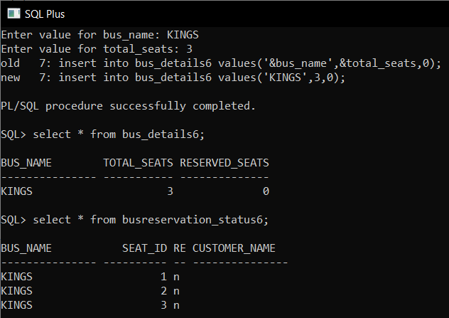
Checking availability of seats

Slide 11
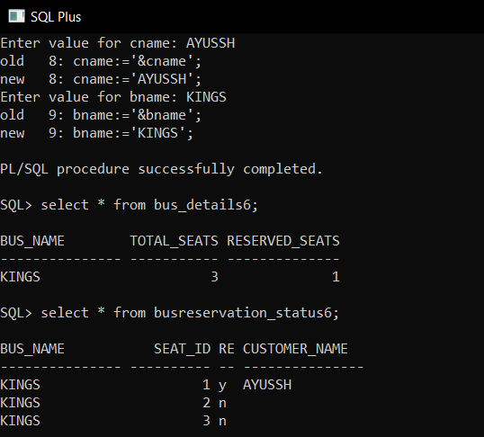
Reservation of tickets

Slide 12
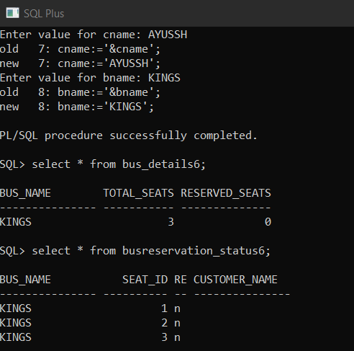
Cancellation of tickets

Slide 13
Thank you

